Slide 1
Collaboration Program Governance
Andy Ioannou

Slide 2
Contents
Context
Current Governance
Collaboration Pipeline
Revised Governance
Revised Collaboration Organisation

Slide 3
Context
The Collaboration program is undergoing some significant changes as it evolves its roadmap for FY14 and FY15
In order to deliver the roadmap ahead, the Collaboration program will need to scale its capability to effectively manage multiple, parallel delivery streams
This means:
  Changing the way in which we govern the program – program reporting cadence, RAID etc
  Re-defining the key roles needed to manage the delivery of parallel streams of work – Project Management and Team Lead roles
  Re-designing the program organisation - transition to matrix model
  Increasing our emphasis on delivery methodology – building delivery approaches in Build, Release Management, Test, Deployment and Support Transition that become repeatable and scalable program assets
  Increasing our focus on engaging with the EY business – building our relationship with the EY business (Service Lines and Functions) to better inform our roadmap, priorities and overall solution quality

Slide 4
Current Program Governance and Reporting Cadence
  Reporting Cadence
Report Type | Reporting Event | Owner
Team Lead Report (Build, Test, Deployment etc) | Weekly (Mon): Reports completed by cob Mon | Team Leads
Team Lead Report (Build, Test, Deployment etc) | Weekly (Tue): Reports reviewed with Program Director at Status Review Meeting | Andy Ioannou
Weekly Program Status Report | Weekly (Thu): Management summary of program status, including key RAID | Andy Ioannou
Monthly Program Status Report | Monthly: Month-on-Month management summary of program status, including key RAID – due last Thu in the month | Andy Ioannou

Slide 5
Current Governance and Reporting Cadence
  Program Governance – Meetings/Calls
Title | Objective | Audience | Owner
Collaboration Daily Call | Effective management of cross-team dependencies, actions Emphasis on items in need of quick turnaround | Program Directors (IT and Business) Solution Delivery Lead Team Leads (including MS) | Team Leads (on rotating basis)
Weekly Collaboration Status Review Meeting | Review of team lead status reports – deliverables, dependencies and key RAID Identify escalations/interventions needed to effectively manage delivery risk/issues | Program Directors (IT and Business) Solution Delivery Lead Team Leads (including MS) | Andy Ioannou
Weekly M&C Program Management Meeting | Review of program status reports – deliverables, dependencies and key RAID Identify escalations/interventions needed to effectively manage delivery risk/issues | All M&C Program Directors (IT and Business) M&C Program PMO | David Bingham
Weekly Collaboration RAID | Review open RAID items and to actively drive ownership and timely resolution Identify items for timely escalation to program leadership | Program Directors (IT and Business) Solution Delivery Lead Team Leads (including MS) | Team Leads (on rotating basis)
Weekly M&C RAID | Review open RAID items flagged for attention of M&C Program leadership | All M&C Program Directors and PMs (IT and Business) M&C Program PMO | David Bingham
Monthly Key IT Initiatives Meeting | Executive review of ITS portfolio of key IT programs – includes M&C | All ITS Program Directors EPM Team | Global PMO

Slide 6
Collaboration Pipeline
Current view of FY14 Pipeline
Release | High Level Scope | Release PM | Status
Release 1 | SP2010→SP2013 Upgrade On Prem Infrastructure Frankfurt) Hybrid Search, MMS, People Profiled Enhanced Team Site functionality | Nicola Cooper | In ‘Execute’ – Test Phase
Release 2 | Enabling SP2013 functionality following GCL5 rollout (mainly Social/Communities capability Enabling basic CMS functionality Concept Searching AutoClassifier integration – enabling rule-driven content tagging UI consistency for SP2013 Search Refiners Enabling ATF/RTF program’s early releases Enabling EYD upgrade to SP2013 platform Enabling Mercury program Basic Document Management Enabling Tax DTU | TBD | In ‘Initiate and Plan’ phase
Extranet Delivery | Rollout out Extranet infrastructure (GDCs: FF, Sing., Sec) Enabling ATF/RTF program’s early releases Enabling EYD upgrade to SP2013 platform | TBD | In ‘Initiate and Plan’ phase
Release 3 | Continue to support EYD upgrade Continue to enable ATF/RTF programs Extend CMS capability Extend Doc Management capability Extend Social capability | TBD | Planning not started

Slide 7
Revised Program Governance and Reporting Cadence
  Revised Reporting Cadence
Report Type | Reporting Event | Owner | Change
Team Lead Report (Build, Test, Deployment etc) | Weekly (Mon): Reports completed by cob Mon | Team Leads | Changes to reporting template to support reporting status of additional releases
Team Lead Report (Build, Test, Deployment etc) | Weekly (Tue): Reports reviewed with Program Director at Status Review Meeting | Release PMs | Team Leads provide update on each release they are supporting (R1, R2 etc) Release PMs lead the session
Weekly Program Status Report | Weekly (Thu): Management summary of program status, including key RAID | Andy Ioannou | Each Release PM responsible for updating report with status of individual release Program Director reviews prior to submission Deadline for Release PM updates cob Wed each week
Monthly Program Status Report | Monthly: Month-on-Month management summary of program status, including key RAID – due last Thu in the month | Andy Ioannou | No change

Slide 8
Current Governance and Reporting Cadence
  Program Governance – Meetings/Calls
Title | Objective | Audience | Owner | Change
Collaboration Daily Call | Effective management of cross-team dependencies, actions Emphasis on items in need of quick turnaround | Program Directors (IT and Business) Solution Delivery Lead Team Leads (including MS) | Release PMs | Call’s scope to include R2 and Extranet as those streams come on line Release PMs host calls – call structured by Release
Weekly Collaboration Status Review Meeting | Review of team lead status reports – deliverables, dependencies and key RAID Identify escalations/interventions needed to effectively manage delivery risk/issues | Program Directors (IT and Business) Release PMs Team Leads (including MS) | Release PMs | Release PMs host call Call structured by Release Team Leads provide updates to each Release PM where deliverables/milestones are planned >1 release
Weekly M&C Program Management Meeting | Review of program status reports – deliverables, dependencies and key RAID Identify escalations/interventions needed to effectively manage delivery risk/issues | All M&C Program Directors (IT and Business) M&C Program PMO | David Bingham | No change
Weekly Collaboration RAID | Review open RAID items and to actively drive ownership and timely resolution Identify items for timely escalation to program leadership | Program Directors (IT and Business) Release PMs Team Leads (including MS) | Release PMs | RAID form modified to capture multiple releases under ‘Project Field’ Call structured by Release
Weekly M&C RAID | Review open RAID items flagged for attention of M&C Program leadership | All M&C Program Directors and PMs (IT and Business) M&C Program PMO | David Bingham | No change
Monthly Key IT Initiatives Meeting | Executive review of ITS portfolio of key IT programs – includes M&C | All ITS Program Directors EPM Team | Global PMO | No change

Slide 9
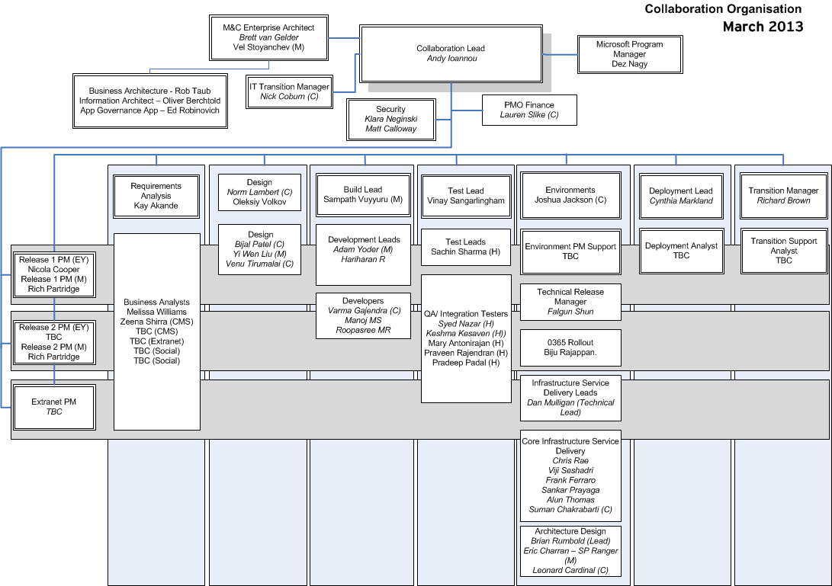
Revised Collaboration Organisation

Slide 10
Revised Collaboration Organisation
Roles and Responsibilities
The program is being re-organised to provide end-to-end delivery focus for each release
Key changes:
  Introduction of Release Project Manager role aligned to each release
  This role is responsible for end-to-end delivery of the release (scope, schedule, budget and quality criteria)
  The role is accountable to the IT Program Director (Andy Ioannou)
  Team Leads are accountable to the Release PMs for deliverables/Milestones in scope of each release
  Focus on building program delivery methodology and capabilities
Each Team Lead is expecting to operate a capacity-planning approach to servicing resource requirements for each Release. This means planning a cross-functional (where possible) resource pool from which multiple release demands can be serviced
The Team Leads will be responsible for sizing the resource pool based on the demand implied by the release roadmap and working with the Program Director to plan any increases in capacity
The Release PM will be responsible for agreeing the resource requirements with each team against which the Release project plan/schedule can be baselined
Any conflicts in cross-release demands will need to be escalated to the IT Program Director for prioritisation/intervention. This will be the responsibility of the Team Lead managing the incoming demand posed by the each release
The Team Leads are responsible for building delivery process, tools and templates (working within their PM communities and leveraging EY’s CLEAR methodology) that supports us in scaling our release schedule and driving consistency in methodology/quality

Slide 11
Roles and Responsibilities
Role | Key Responsibilities
Collaboration Program Lead (Andy Ioannou) | Accountable for directing resources to achieve program scope, schedule and cost objectives Accountable for overall delivery to baseline plan (time, cost, scope, quality) Accountable for program governance and control, including program status reporting up to Exec Steer Comm. Accountable for people management in line with E&Y HR policies
Release Project Manager | Responsible for end-to-end delivery (all project/release phases) of the solution to baseline plan, budget, scope and quality criteria Accountable for timely identification, management and control of risks and issues to delivery, including escalations to Program Lead Responsible for people management in line with E&Y HR policies

Slide 12
Roles and Responsibilities
Role | Key Responsibilities
Lead Business Analyst (Kay Akande) | Supports Business Program Lead in preparation of release candidate scope for prioritisation with business Responsible for managing the business analyst team to agreed project/release scope Responsible for planning and execution of business requirements activities and securing business sign-off against plan Responsible for definition and production of team deliverables against plan and budget Responsible for managing delivery within area to baseline plan Responsible for timely identification, management and control of risks and issues to delivery, including escalations to Release PM Responsible for timely production of status reports Responsible for people management in line with E&Y HR policies
Solution Design Lead (Oleksiy Volkov) | Accountable for ensuring solution design meets detailed business requirements Responsible for managing the Architecture/Design team to agreed project/release scope Responsible for definition and production of team deliverables against plan and budget Responsible for managing delivery within area to baseline plan Responsible for timely identification, management and control of risks and issues to delivery, including escalations Responsible for timely production of status reports Responsible for people management in line with E&Y HR policies

Slide 13
Roles and Responsibilities
Role | Key Responsibilities
Build Lead (Rich Partridge) | Responsible for build of solution against functional and technical specifications and to required quality level (resolution of software defects identified in unit testing) Responsible for definition and production of team deliverables against plan and budget Responsible for managing delivery within area to baseline plan Responsible for timely identification, management and control of risks and issues to delivery, including escalations Responsible for timely production of status reports Responsible for Build team people management in line with E&Y HR policies
Test Lead (Vinay Sangarlingham) | Responsible for solution quality through the planning and execution of functional and performance testing Manages the planning and execution of all test phases: QA Testing, Integration Testing and Performance Testing Responsible for definition and production of team deliverables against plan and budget Responsible for managing delivery within area to baseline plan Responsible for timely identification, management and control of risks and issues to delivery, including escalations Responsible for timely production of status reports Responsible for Test team people management in line with E&Y HR policies

Slide 14
Roles and Responsibilities
Role | Key Responsibilities
Environments Lead (Joshua Jackson) | Accountable for the strategic solution architecture design Manages provision of environments/infrastructure against this design Responsible for definition and production of team deliverables against plan and budget Responsible for managing delivery within area to baseline plan Responsible for timely identification, management and control of risks and issues to delivery, including escalations Responsible for timely production of status reports Responsible for Environment team people management in line with E&Y HR policies
Deployment Lead (Cynthia Markland) | Defines the deployment approach and ensures alignment with Business Deployment approach Manages the planning and execution of all deployment activities, including technical release management and cutover Defines and manages the ‘Go/No Go’ process Responsible for definition and production of team deliverables against plan and budget Responsible for managing delivery within area to baseline plan Responsible for timely identification, management and control of risks and issues to delivery, including escalations Responsible for timely production of status reports Responsible for Deployment team people management in line with E&Y HR policies

Slide 15
Roles and Responsibilities
Role | Key Responsibilities
Business Change Lead (Martin Kremmer) | Defines the business change strategy and aligns with E&Y internal business change services – e.g. Training and Communications Responsible for definition and production of team deliverables against plan and budget Responsible for managing delivery within area to baseline plan Responsible for timely identification, management and control of risks and issues to delivery, including escalations Responsible for timely production of status reports
Transition Lead (Richard Brown) | Defines the transition approach and ensures alignment with the deployment plan Manages the planning and execution of all transition activities to assure operational readiness for service support Ensures transition milestone criteria are aligned to EY service management process requirements Responsible for definition and production of team deliverables against plan and budget Responsible for managing delivery within area to baseline plan Responsible for timely identification, management and control of risks and issues to delivery, including escalations Responsible for timely production of status reports Responsible for transition team people management in line with E&Y HR policies

